Slide 1
Boosting Algorithms
By
Dr. S PADMANABHAN

Slide 2
Boosting
Boosting is an ensemble learning method that combines a set of weak learners into strong learners to minimize training errors.
In boosting, a random sample of data is selected, fitted with a model, and then trained sequentially. That is, each model tries to compensate for the weaknesses of its predecessor.
Each classifier's weak rules are combined with each iteration to form one strict prediction rule.

Slide 3
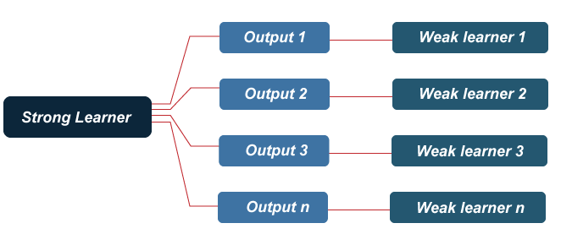
Boosting
Boosting is an efficient algorithm that converts a weak learner into a strong learner. They use the concept of the weak learner and strong learner conversation through the weighted average values and higher votes values for prediction. These algorithms use decision stamp and margin maximizing classification for processing.

Slide 4
Example
Let's understand this concept with the help of the following example.
Let's take the example of the email. How will you recognize your email, whether it is spam or not? You can recognize it by the following conditions:
If an email contains lots of sources, that means it is spam.
If an email contains only one file image, then it is spam.
If an email contains the message "You Own a lottery of $xxxxx," it is spam.
If an email contains some known source, then it is not spam.
If it contains the official domain like educba.com, etc., it is not spam.
The rules mentioned above are not that powerful to recognize spam or not; hence these rules are called weak learners.

Slide 5
How does the Boosting Algorithm Work?
The basic principle behind the working of the boosting algorithm is to generate multiple weak learners and combine their predictions to form one strict rule. These weak rules are generated by applying base Machine Learning algorithms on different distributions of the data set. These algorithms generate weak rules for each iteration. After multiple iterations, the weak learners are combined to form a strong learner that will predict a more accurate outcome.

Slide 6
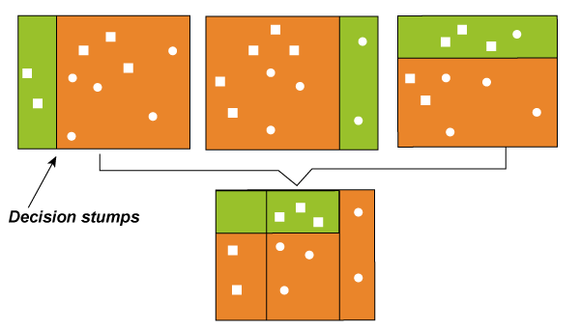

Slide 7
Here's how the algorithm works:
Step 1: The base algorithm reads the data and assigns equal weight to each sample observation.
Step 2: False predictions made by the base learner are identified. In the next iteration, these false predictions are assigned to the next base learner with a higher weightage on these incorrect predictions.
Step 3: Repeat step 2 until the algorithm can correctly classify the output.
Therefore, the main aim of Boosting is to focus more on miss-classified predictions.

Slide 8
To convert weak learners to the strong learner, combine the prediction of the weak learner using the following methods.
Using average or weighted average.
Consider prediction has a higher vote.
Consider the 5 rules mentioned above; there are 3 votes for spam and 2 votes for not spam. Since there is high vote spam, we consider it spam.

Slide 9
Types of Boosting
There are three types of Boosting Algorithms available such as
AdaBoost or Adaptive boosting Algorithm,
Gradient, and
XG Boosting algorithm.
These are the machine learning algorithms that follow the process of training for predicting and fine-tuning the result.

Slide 10
1. Adaptive boosting or AdaBoost:
This method operates iteratively, identifying misclassified data points and adjusting their weights to minimize the training error. The model continues to optimize sequentially until it yields the strongest predictor.
AdaBoost is implemented by combining several weak learners into a single strong learner. The weak learners in AdaBoost take into account a single input feature and draw out a single split decision tree called the decision stump. Each observation is weighted equally while drawing out the first decision stump.

Slide 11
The results from the first decision stump are analyzed, and if any observations are wrongfully classified, they are assigned higher weights. A new decision stump is drawn by considering the higher-weight observations as more significant. Again if any observations are misclassified, they're given a higher weight, and this process continues until all the observations fall into the right class.
AdaBoost can be used for both classification and regression-based problems. However, it is more commonly used for classification purposes.

Slide 12
2. Gradient Boosting:
Gradient Boosting is also based on sequential ensemble learning. Here the base learners are generated sequentially so that the present base learner is always more effective than the previous one, i.e., and the overall model improves sequentially with each iteration.
The difference in this boosting type is that the weights for misclassified outcomes are not incremented. Instead, the Gradient Boosting method tries to optimize the loss function of the previous learner by adding a new model that adds weak learners to reduce the loss function.

Slide 13
The main idea here is to overcome the errors in the previous learner's predictions. This boosting has three main components:
Loss function: The use of the loss function depends on the type of problem. The advantage of gradient boosting is that there is no need for a new boosting algorithm for each loss function.
Weak learner: In gradient boosting, decision trees are used as a weak learners. A regression tree is used to give true values, which can combine to create correct predictions. Like in the AdaBoost algorithm, small trees with a single split are used, i.e., decision stump. Larger trees are used for large levels,e, 4-8.

Slide 14
Additive Model: Trees are added one at a time in this model. Existing trees remain the same. During the addition of trees, gradient descent is used to minimize the loss function.
Like AdaBoost, Gradient Boosting can also be used for classification and regression problems.

Slide 15
3. Extreme gradient boosting or XGBoost:
XGBoost is an advanced gradient boosting method. XGBoost, developed by Tianqi Chen, falls under the Distributed Machine Learning Community (DMLC) category.
The main aim of this algorithm is to increase the speed and efficiency of computation. The Gradient Descent Boosting algorithm computes the output slower since they sequentially analyze the data set. Therefore XGBoost is used to boost or extremely boost the model's performance.

Slide 16
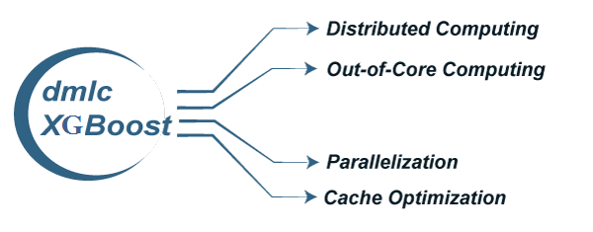
XGBoost is designed to focus on computational speed and model efficiency. The main features provided by XGBoost are:

Slide 17
Parallel Processing: XG Boost provides Parallel Processing for tree construction which uses CPU cores while training.
Cross-Validation: XG Boost enables users to run cross-validation of the boosting process at each iteration, making it easy to get the exact optimum number of boosting iterations in one run.
Cache Optimization: It provides Cache Optimization of the algorithms for higher execution speed.
Distributed Computing: For training large models, XG Boost allows Distributed Computing.

Slide 18
Benefits and Challenges of Boosting
The boosting method presents many advantages and challenges for classification or regression problems.
The benefits of boosting include:
Ease of Implementation: Boosting can be used with several hyper-parameter tuning options to improve fitting. No data preprocessing is required, and boosting algorithms have built-in routines to handle missing data. In Python, the sci-kit-learn library of ensemble methods makes it easy to implement the popular boosting methods, including AdaBoost, XGBoost, etc.

Slide 19
Reduction of bias: Boosting algorithms combine multiple weak learners in a sequential method, iteratively improving upon observations. This approach can help to reduce high bias, commonly seen in shallow decision trees and logistic regression models.
Computational Efficiency: Since boosting algorithms have special features that increase their predictive power during training, it can help reduce dimensionality and increase computational efficiency.

Slide 20
And the challenges of boosting include:
Overfitting: There's some dispute in the research around whether or not boosting can help reduce overfitting or make it worse. We include it under challenges because in the instances that it does occur, predictions cannot be generalized to new datasets.
Intense computation: Sequential training in boosting is hard to scale up. Since each estimator is built on its predecessors, boosting models can be computationally expensive, although XGBoost seeks to address scalability issues in other boosting methods. Boosting algorithms can be slower to train when compared to bagging, as a large number of parameters can also influence the model's behavior.

Slide 21
Vulnerability to outlier data: Boosting models are vulnerable to outliers or data values that are different from the rest of the dataset. Because each model attempts to correct the faults of its predecessor, outliers can skew results significantly.
Real-time implementation: We might find it challenging to use boosting for real-time implementation because the algorithm is more complex than other processes. Boosting methods have high adaptability, so you can use various model parameters that immediately affect the model's performance.

Slide 22
Applications of Boosting
Boosting algorithms are well suited for artificial intelligence projects across a broad range of industries, including:
Healthcare: Boosting is used to lower errors in medical data predictions, such as predicting cardiovascular risk factors and cancer patient survival rates. For example, research shows that ensemble methods significantly improve the accuracy in identifying patients who could benefit from preventive treatment of cardiovascular disease while avoiding unnecessary treatment of others. Likewise, another study found that applying boosting to multiple genomics platforms can improve the prediction of cancer survival time.

Slide 23
IT: Gradient boosted regression trees are used in search engines for page rankings, while the Viola-Jones boosting algorithm is used for image retrieval. As noted by Cornell, boosted classifiers allow the computations to be stopped sooner when it's clear which direction a prediction is headed. A search engine can stop evaluating lower-ranked pages, while image scanners will only consider images containing the desired object.
Finance: Boosting is used with deep learning models to automate critical tasks, including fraud detection, pricing analysis, and more. For example, boosting methods in credit card fraud detection and financial product pricing analysis improves the accuracy of analyzing massive data sets to minimize financial losses.

Slide 24
Advantages of Boosting
Improved Accuracy – Boosting can improve the accuracy of the model by combining several weak models’ accuracies and averaging them for regression or voting over them for classification to increase the accuracy of the final model.
Robustness to Overfitting – Boosting can reduce the risk of overfitting by reweighting the inputs that are classified wrongly.
Better handling of imbalanced data – Boosting can handle the imbalance data by focusing more on the data points that are misclassified
Better Interpretability – Boosting can increase the interpretability of the model by breaking the model decision process into multiple processes.

Slide 25
Disadvantages of Boosting Algorithms
Boosting algorithms also have some disadvantages these are:
Boosting Algorithms are vulnerable to the outliers
It is difficult to use boosting algorithms for Real-Time applications.
It is computationally expensive for large datasets

Slide 26
Boosting vs Bagging
Boosting | Bagging
In Boosting we combine predictions that belong to different types | Bagging is a method of combining the same type of prediction
The main aim of boosting is to decrease bias, not variance | The main aim of bagging is to decrease variance not bias
At every successive layer Models are weighted according to their performance. | All the models have the same weightage
New Models are influenced by the accuracy of previous Models | All the models are independent of each other

Slide 27
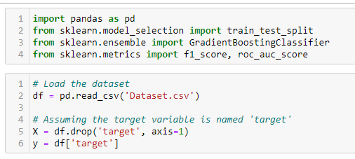
Python codes for implementing Boosting, AdaBoost, and XGBoost models.
1. Gradient Boosting
Gradient Boosting is an ensemble technique that builds models sequentially, each new model correcting errors made by the previous ones.

Slide 28
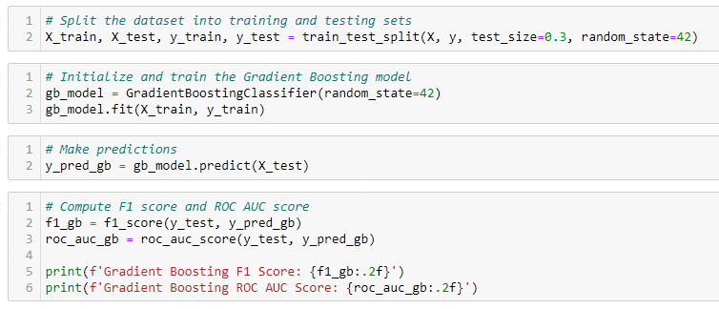

Slide 29
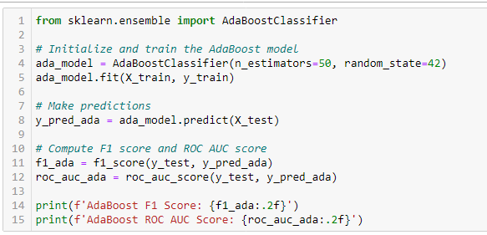
2. AdaBoost
AdaBoost (Adaptive Boosting) combines multiple weak classifiers to create a strong classifier.

Slide 30
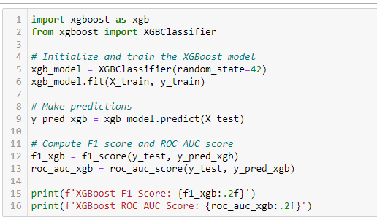
3. XGBoost
XGBoost (Extreme Gradient Boosting) is an optimized distributed gradient boosting library designed to be highly efficient, flexible, and portable.

